Slide 1
Smart Evaluation: Incorporating Evaluation in Program Design, & Showing Contractors the Benefits
Kathy Greely
Program Manager, PA Home Energy
Performance Systems Development

Slide 2
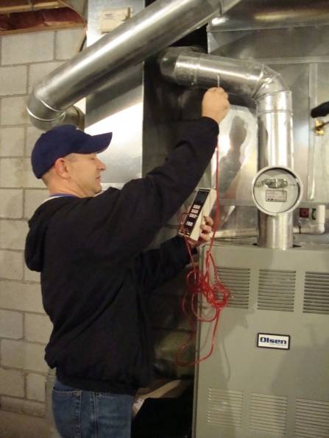
PA Home Energy
HPwES and ESQH
Infrastructure Development
More auditors/raters
Dual RESNET/BPI certification
Financing & Incentives
Keystone HELP loans
Performance-based (WPP)
Consumer Marketing
Benefits of whole-house approach
Contractor differentiation
ENERGY STAR link
www.pahomeenergy.org

Slide 3
Starting from Zero

Slide 4
Home Performance with ENERGY STAR
Whole house energy improvement process
Diagnostic Audit
Report to the customer
Modeled savings (optional)
Installation
Test out

Slide 5
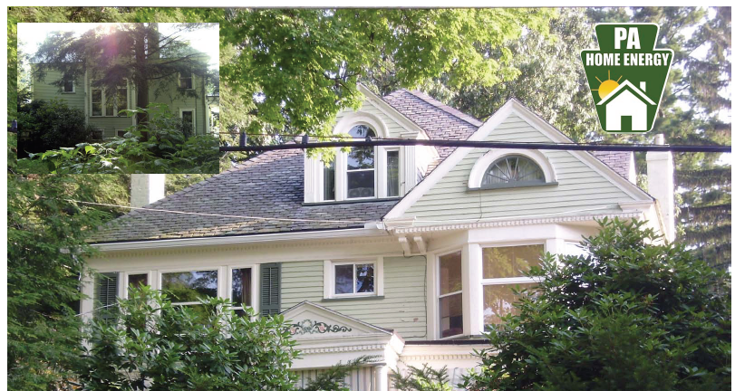
Growth in Reported Jobs
Home Performance with ENERGY STAR
623 audits, plus
172 completed home performance jobs
HomeWorks (Lisbet Searle-White)

Slide 6
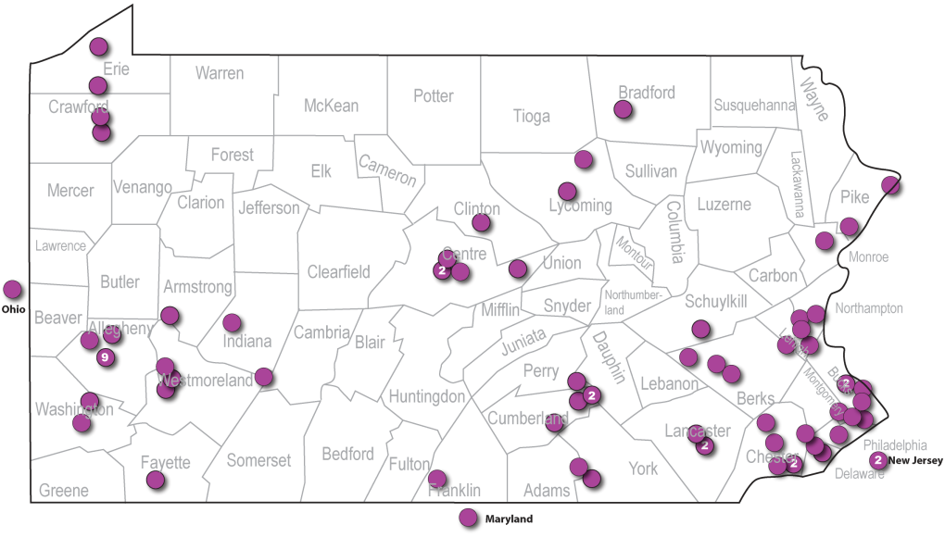
Program Features
Young (< 3 years)
Relatively low budget
Not utility funded, but may be
Wide geographic range

Slide 7
More Program Features
Performance-based incentives (limited territory)
Based on modeled savings, trued up to bills
Little money to incent reporting otherwise
Emphasis on billing data
Benchmarking
Disaggregation (true up/improvement opportunities)
No evaluation funds, but some built in features

Slide 8
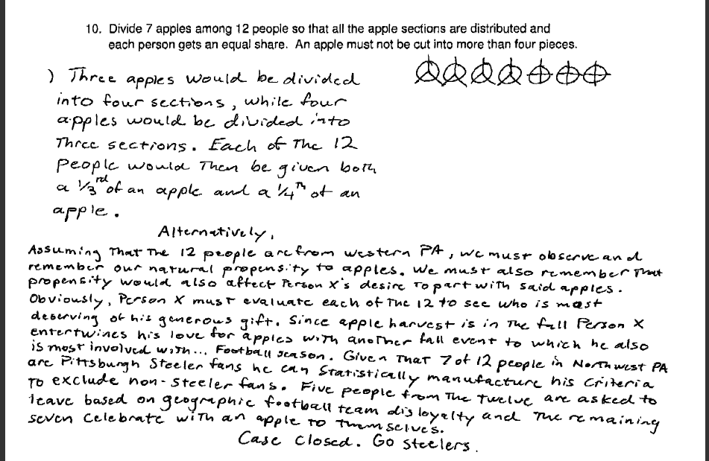
Training
Focus on trainees who can succeed

Slide 9
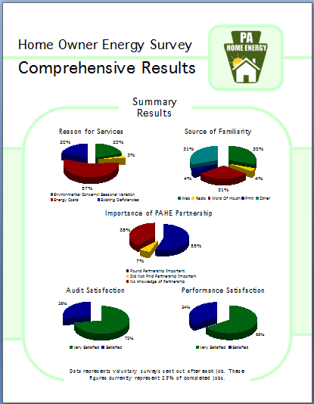
Evaluation: Customer Feedback

Slide 10
Obtaining Utility Bills?

Slide 11
Obtaining Utility Bills?

Slide 12
File Review, by Contractor
Savings:
Too low?
Unrealistically high?
Whole-house scope?
Combustion testing?

Slide 13
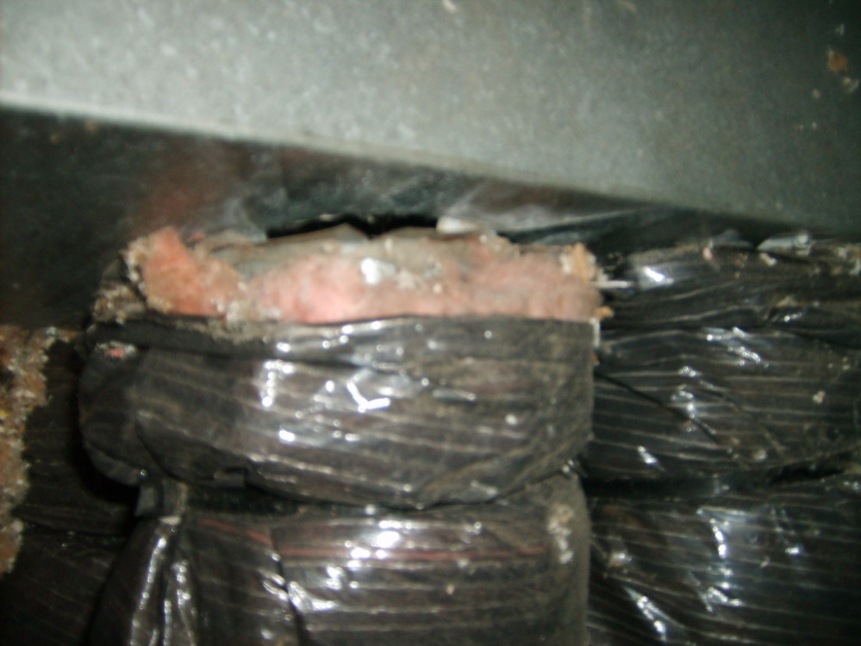
Field QA: Front-Line Evaluation
What are we looking for?
Home performance jobs:
Heath & Safety issues
Combustion Safety compliance
Infiltration verification
Installation inspection
Missed opportunities
Common problem areas
CAZ depressurization
Ducts outside the envelope

Slide 14
Getting Contractors to Report
Balance reporting quality and quantity
Too much information means less reporting
Competition valuable
AWARDS

Slide 15
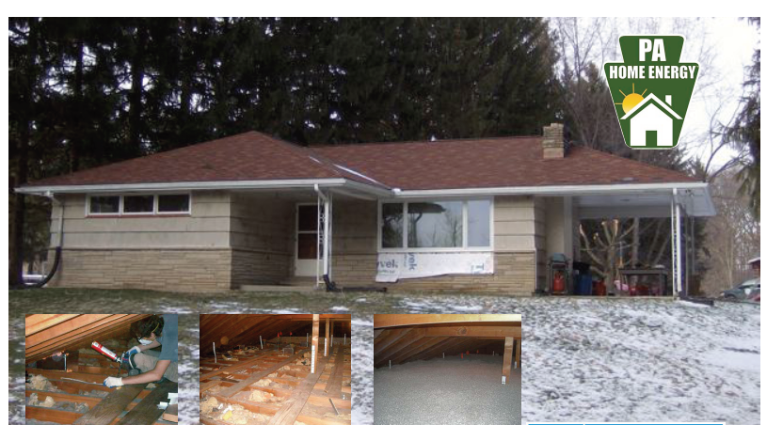
Deep Savers
Home Performance with ENERGY STAR:
Rhett Major, Billeck Home, 71% savings
GSHP
Air sealing
Insulation
Windows
Ventilation

Slide 16
Getting Contractors to Report
Reporting must be easy (especially with small/variable incentives)
Reporting must be useful to contractor
Customer feedback, file management, tracking
Paper/fax/email to on-line reporting
Less suffering, greater results
Benefit to participants

Slide 17
Green Energy Compass

Slide 18
Green Energy Compass is …
An online benchmarking and tracking tool for single-family residential homes
Sold as Software-As-A-Service, meaning there is nothing to download or install and the application is always up to date (free to PAHE)
Designed to support the entire residential energy retrofit process

Slide 19
Useful to Contractors for…
Client education and benchmarking (pre-audit)
Disaggregation for model true-up (audit)
Feedback to clients (post HP)
File management (audit/HP/test-out)
Program reporting (value, not burden)

Slide 20
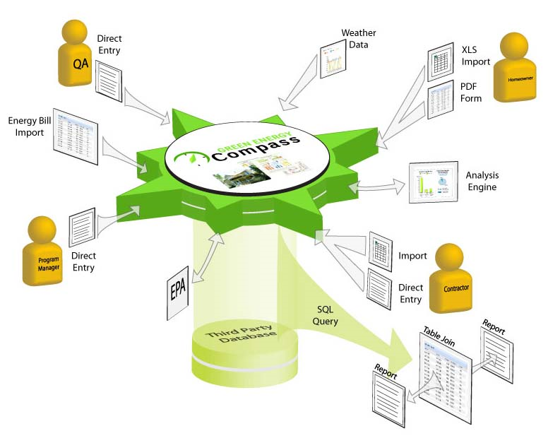
Green Energy Compass
Green Energy Compass provides a central hub for collecting and disbursing information to all interested parties including contractors, programs, and financial institutions

Slide 21
Green Energy Compass answers your questions
How is this home using energy?
How can I keep track of all my documents?
How much $ could I save?
How does this home compare to similar homes?
How much did I actually save?
Can this home qualify for an energy efficient loan?

Slide 22
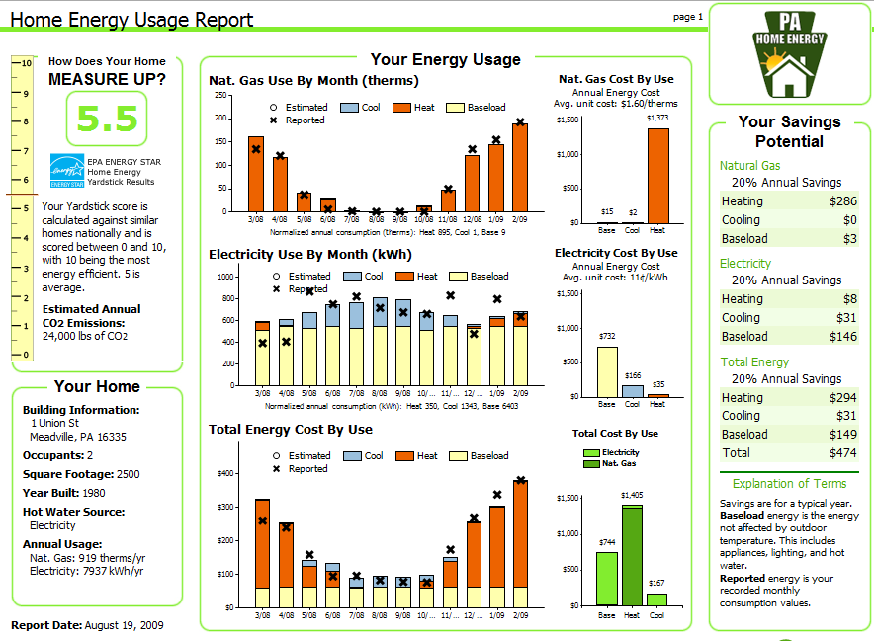
Energy Usage Report
What is biggest use of energy in home?
What is biggest use of energy in the home?
How does home compare to national average?
How much can the homeowner spend on improvements?
Model true-up info
What is costing the most for energy?

Slide 23
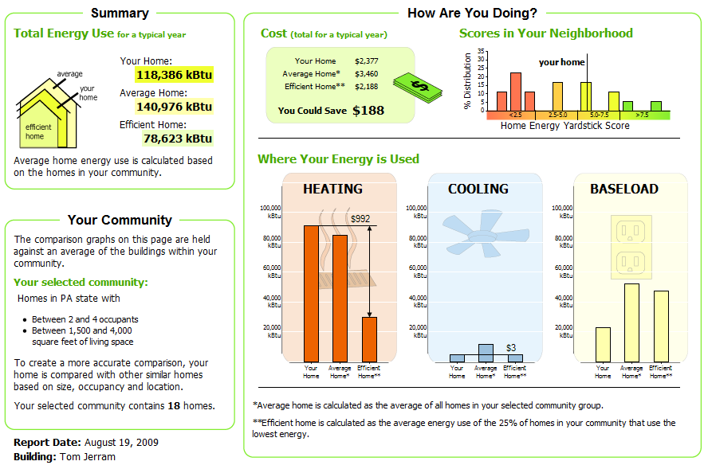
Peer Comparison Report
Total Energy comparison yields first level analysis.
But comparison of end use shows that totals were masking a heating improvement opportunity.

Slide 24
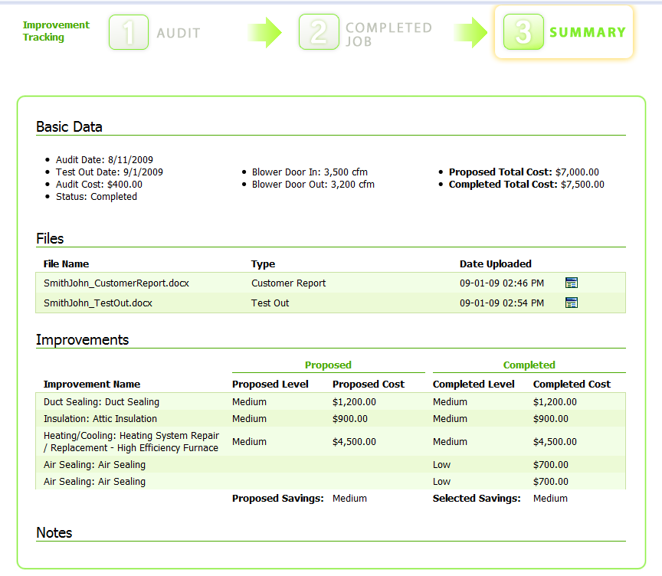
Improvement Summary
Three stage process to capture information
Basic information about the audit and test-out
Files from contractor to support program QA
List of improvements and proposed savings
Free notes allow easy communication between contractor and program

Slide 25
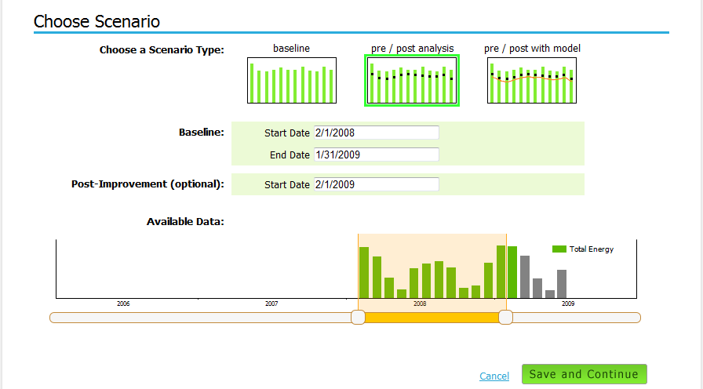
Configure Energy Savings Report
The type of report controls what inputs are required
Easily set the baseline period based on actual meter data

Slide 26
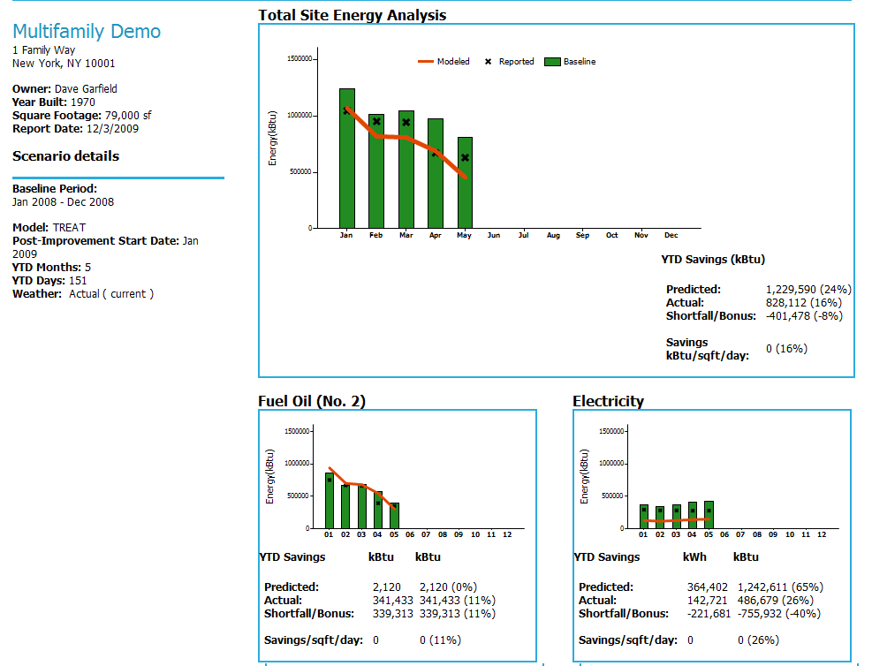
Energy Savings Report

Slide 27
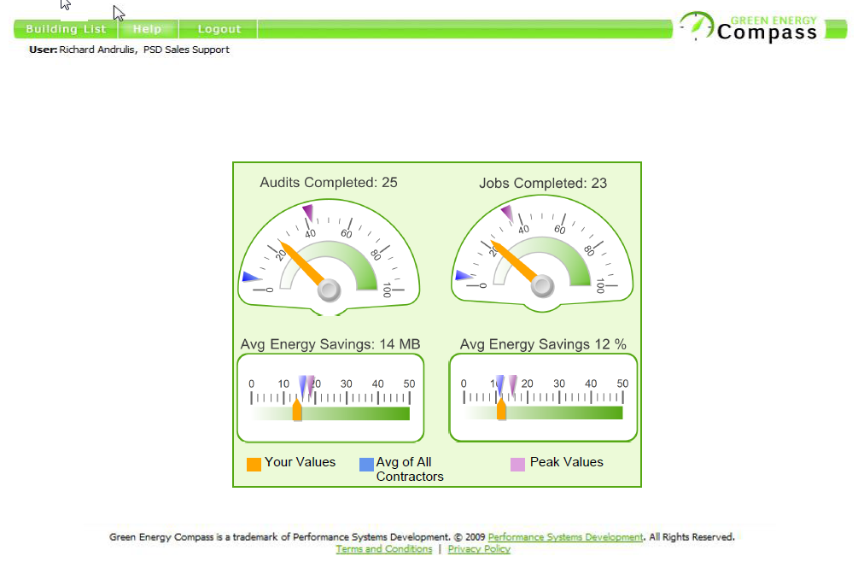
Dashboard – Peer comparison for Contractors

Slide 28
Thank you!
Kathy Greely
www.pahomeenergy.org
(814) 558-8082
kgreely@psdconsulting.com

